Slide 1
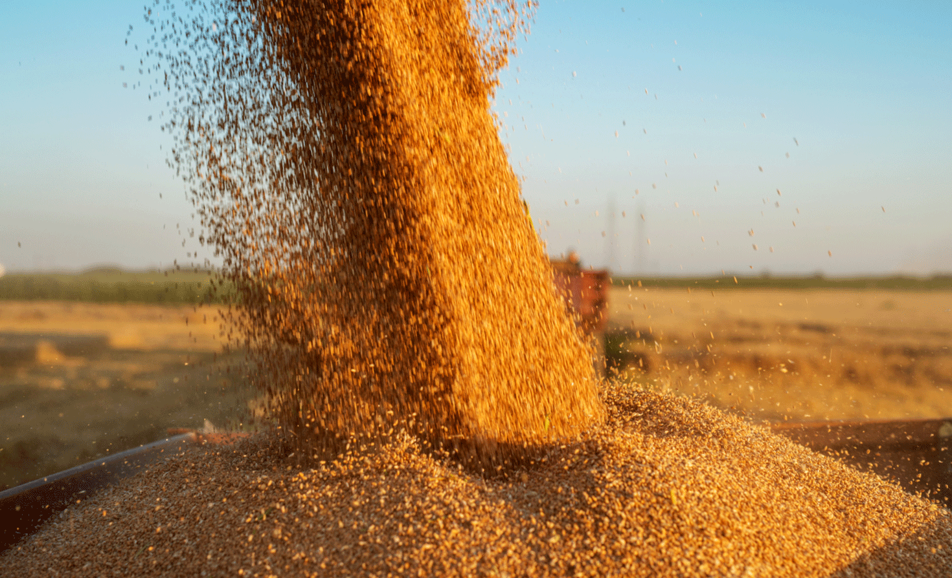
Exploring Crop Yield Prediction Using Machine Learning Techniques
CIS 890
Introduction To Food Informatics
REVANTH BABU RAAVI
DR. HANDE KUCUK MCGINTY

Slide 2
INDEXING
Introduction
Data collection
Data Processing
Model Comparison
User Interface
Results

Slide 3
Introduction
Climatic and Soil characteristics play a major role in agriculture in order to produce more yield.
But traditional farming practices often involve planting the same type of crops, using excessive fertilizers, and following conventional wisdom.
This project aims to use Machine Learning model to predict the yield of the crops so that it will be beneficial for the farmers by meeting their requirements.

Slide 4
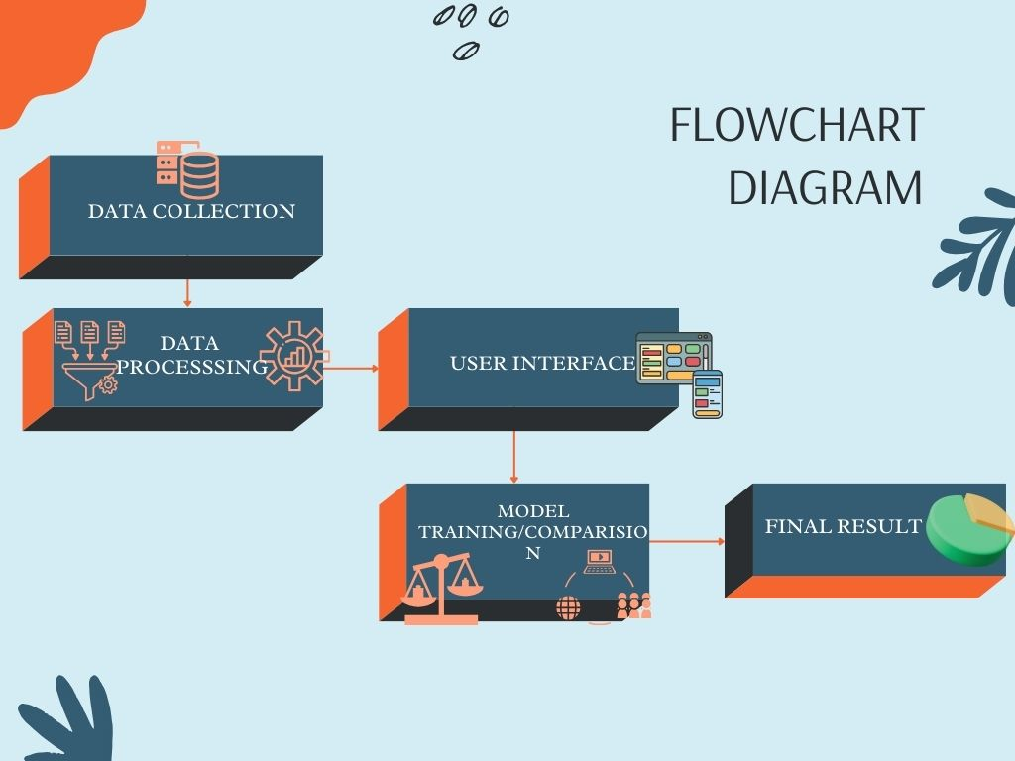
workflow

Slide 5
SOFTWARE REQUIREMENTS
IDE – VSCODE / PYCHARM
FRAMEWORK – FLASK
EDITOR – GOOGLE COLAB
WEBSERVER – XAMPP
GUI tool for managing and interacting MySQL databases - SQLYOG

Slide 6
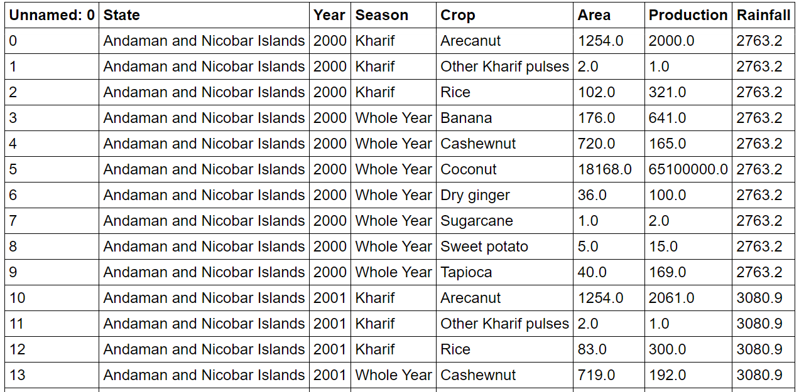
Data Collection
Data was collected from Open Source Data Library: Kaggle
https://www.kaggle.com/datasets/chinmaynagesh/crop-yield-per-state-and-rainfall-data-of-india?resource=download
No units, But units had to be assumed for removing redundancy

Slide 7
Data processing
Checking the data if anything needs to be removed like null values and unnecessary columns.
Conversion of string values to numerical values if present.
Making the data clean so that the model acquires it for training and testing purposes.

Slide 8
PICKING THE MODEL
Predicting the yield of a crop involves calculating continuous numerical data as output, based on input data.
Here comes, Regression models into the action, which specifies relationship between independent variables and dependent variables(X and Y).

Slide 9
Bagging REGRESSOR
Bagging Regressor works by training multiple regression models on bootstrapped subsets of the data, combining their predictions through averaging to reduce variance and overfitting, resulting in a more stable and generalized model.

Slide 10
SUPPORT VECTOR REGRESSOR
Support Vector Regression (SVR) works by finding a hyperplane that best fits the data within a specified margin of tolerance (epsilon), aiming to minimize errors while maximizing the margin. Using kernel functions, SVR handles nonlinear relationships, focusing on support vectors within an epsilon-insensitive tube to build a robust regression model that generalizes well to new data.
SVM chooses the extreme points/vectors that help in creating the hyperplane. These extreme cases are called as support vectors, and hence algorithm is termed as Support Vector.

Slide 11
K-nearest neighbor regressor
K-NN algorithm assumes the similarity between the new case/data and available cases and put the new case into the category that is most similar to the available categories.
K-NN algorithm stores all the available data and classifies a new data point based on the similarity.

Slide 12
Extra tree regressor
The Extra Trees Regressor constructs an ensemble of decision trees with increased randomness by selecting random features and thresholds at each node split. By aggregating predictions from these diverse trees, it aims to reduce overfitting while maintaining predictive accuracy, forming a robust regression model suitable for handling complex datasets.

Slide 13
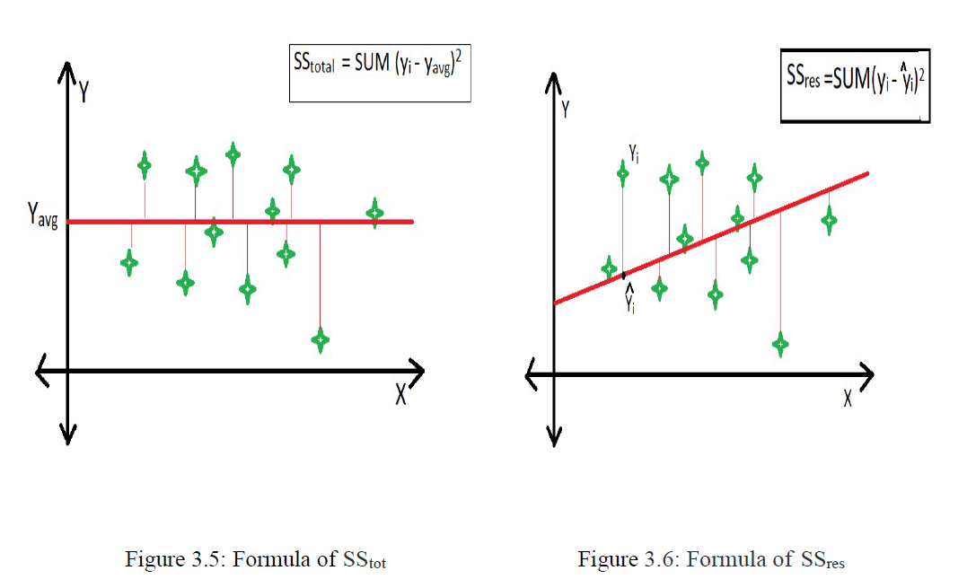
R-squared
Take y_pred values.
y_mean = np.mean(y_actual)
ss_tot = np.sum((y_actual - y_mean) ** 2)
ss_res = np.sum((y_actual - y_pred) ** 2)
r_squared = 1 - (ss_res / ss_tot)
where,
y_pred are predicted values
y_actual are y_test values
y_mean is mean of y_test
SSres is the sum of the squares of the residual mistakes.
SStot is the entire sum of the errors.

Slide 14
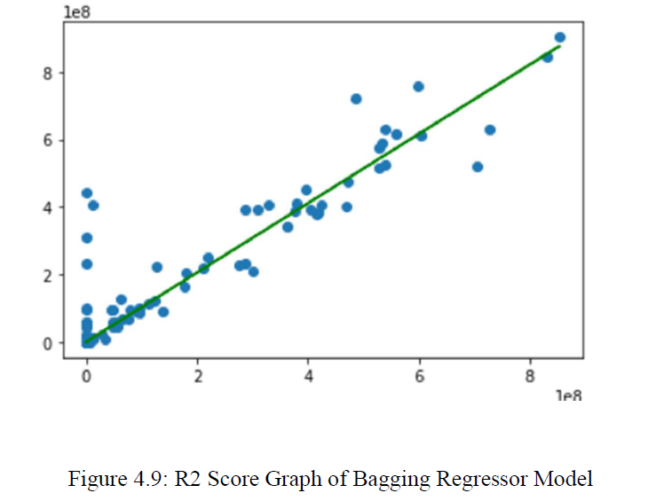
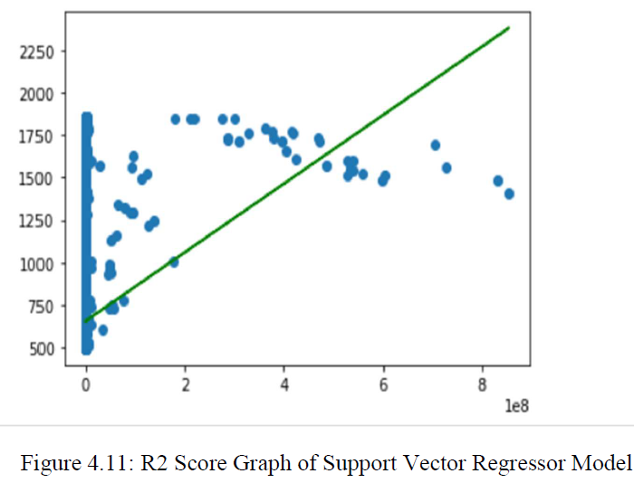
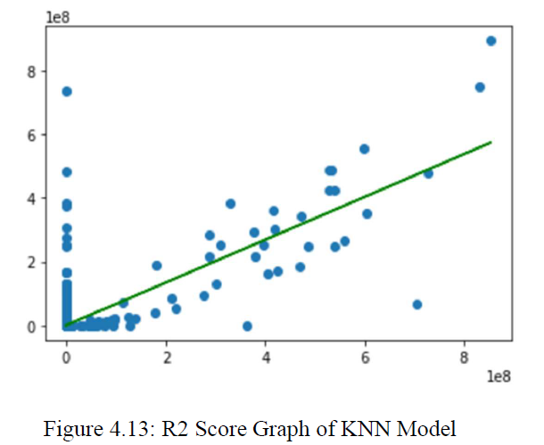
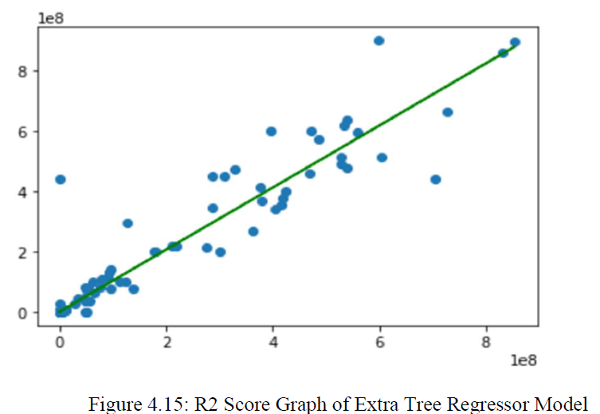
MODEL COMPARISON

Slide 15
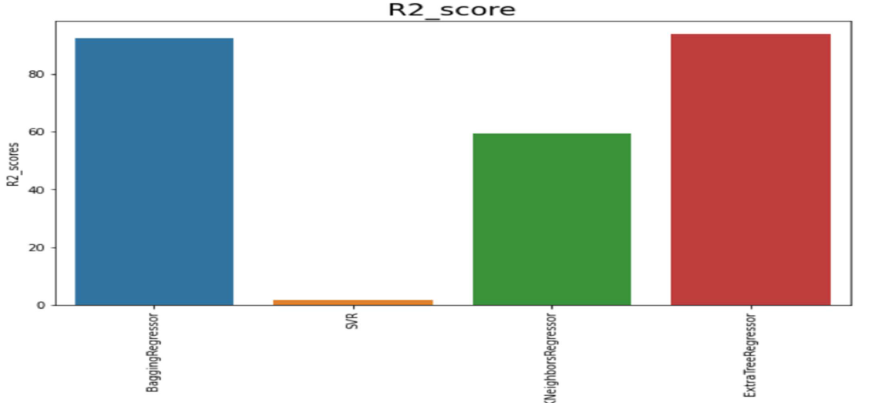
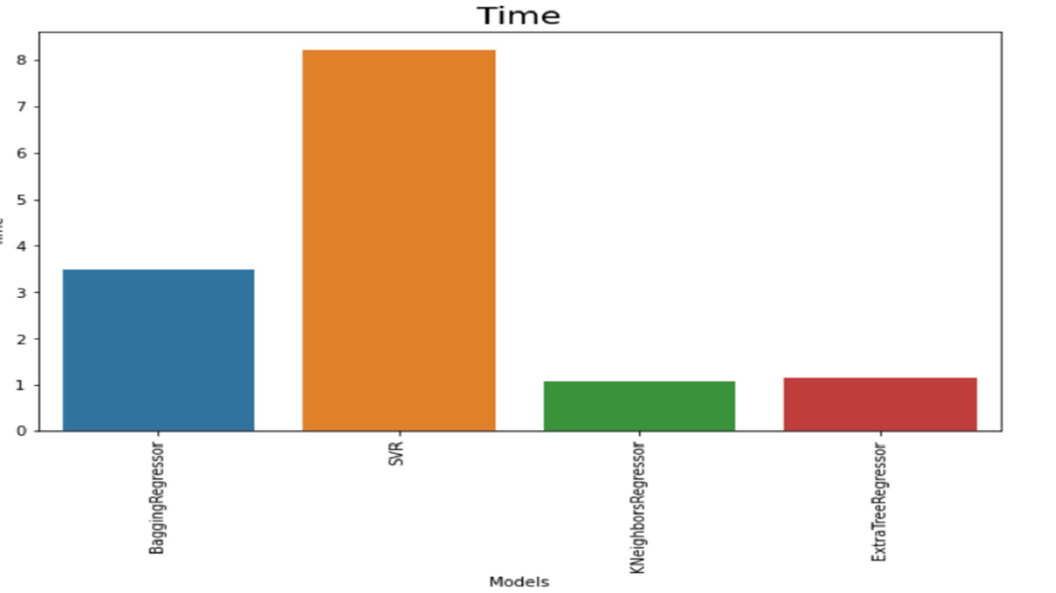
Bar graph of r2_score and time

Slide 16
Best Model
Out of all the models, Extra –Tree Regressor model achieved high accuracy with almost least time.
Extra Tree Regression with R-squared (R2) is valued at almost 0.95056218199, though sometimes fluctuates which is common.
It took just approx. 1.5 sec to execute.

Slide 17
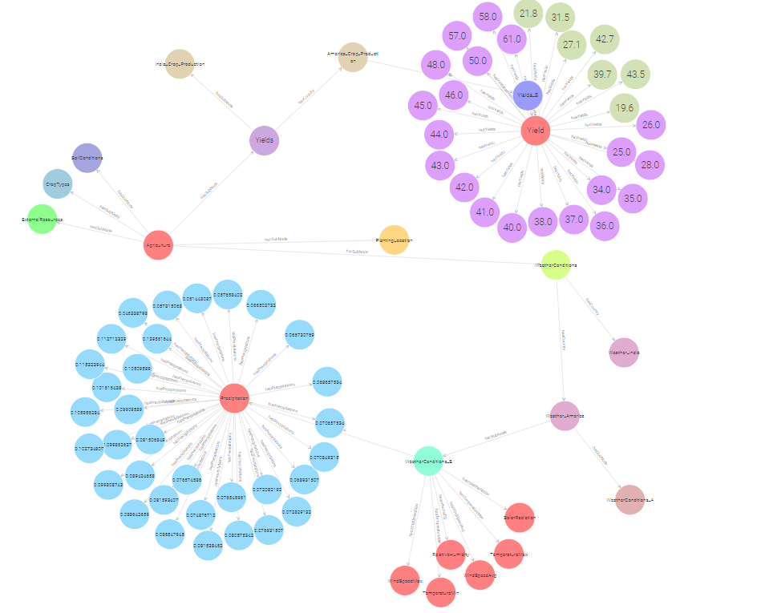
GRAPH DB Instance

Slide 18
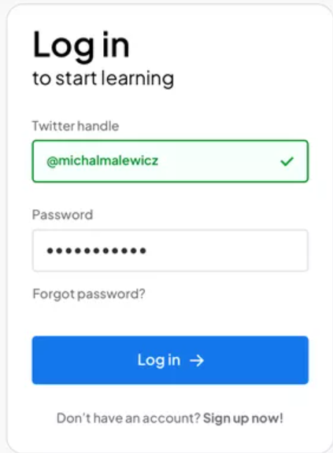
User Interface

Slide 19
Future work
Add more features to dataset and check how the ML models are performing to predict the yield.
Applying Knowledge graphs and checking how the models are reacting.

Slide 20
Thank you

